Slide 1
Regression Ordinary Least Square LASSO & RIDGE

Slide 2
Simple Linear Regression
The simple linear regression is a model with a single regressor (independent variable) x that has a relationship with a response (dependent or target) y that is a
y = β0 + β1 x + ε
Where β0: intercept
β1: slope (unknown constant)
ε: random error component
This is a line where y is the dependent variable we want to predict, x is the independent variable, and β0 and β1 are the coefficients that we need to estimate.

Slide 3
Linear Regression
Linear regression model: LASSO regression starts with the standard linear regression model, which assumes a linear relationship between the independent variables (features) and the dependent variable (target). The linear regression equation can be represented as follows:
y = β₀ + β₁x₁ + β₂x₂ + ... + βₚxₚ + ε
Where:
y is the dependent variable (target).
β₀, β₁, β₂, ..., βₚ are the coefficients (parameters) to be estimated.
x₁, x₂, ..., xₚ are the independent variables (features).
ε represents the error term.

Slide 4
Ordinary Least Squares regression (OLS)
Ordinary Least Squares regression (OLS) is a common technique for estimating coefficients of linear regression equations that describe the relationship between one or more independent quantitative variables and a dependent variable (simple or multiple linear regression).
Least squares stand for the minimum squares error (SSE). Maximum likelihood and Generalized method of moments estimator are alternative approaches to OLS.

Slide 6
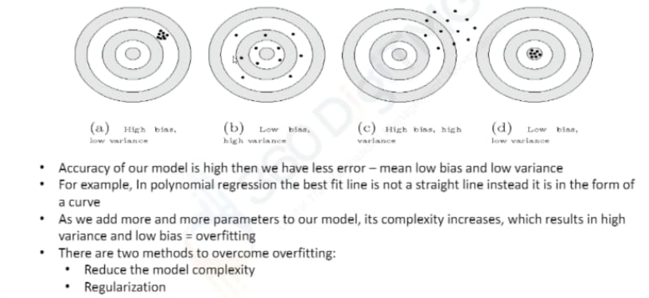
Bias and Variance

Slide 7
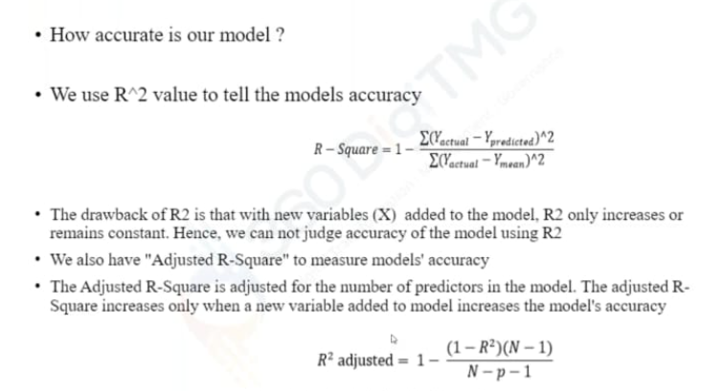
R Square and Adjusted R Square

Slide 8
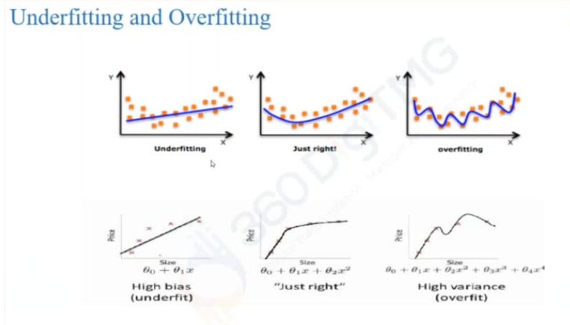

Slide 10
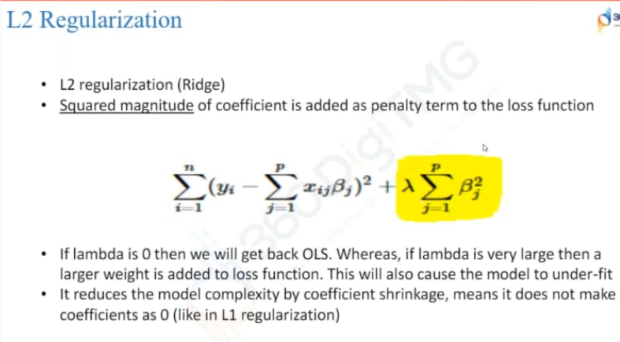
L2 Regularization (Ridge)

Slide 11
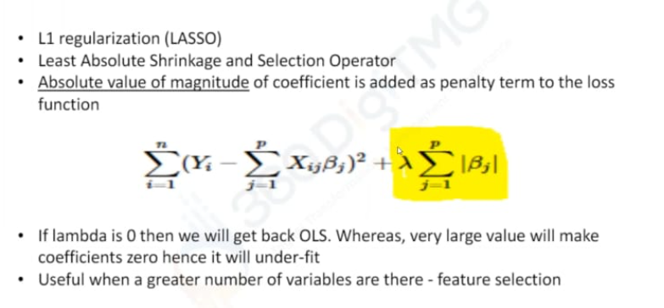
L1 Regularization (LASSO)

Slide 12
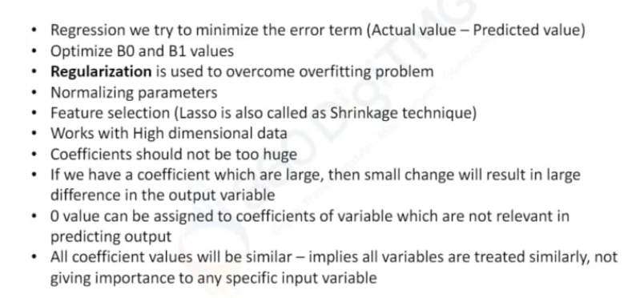
Regularization

